Slide 1
Python Introduction
By Dr Shantanu Pathak

Slide 2
Python History
Successor to ABC programming language
Designed By : Guido van Rossum
First release : 1991
Library Support
Built in Libraries : 100+
Total Libraries : 100,000+

Slide 3
Unique Features of Python
User Friendly
Flexibility in Variable Data types
Vectorised Operations
Easy to handle arrays / matrices / tables etc
Huge community support
Automation and Data Science Stack support
Open Source

Slide 4
Unique Features of Python
Scripting Language
Easy to learn syntax and still powerful like programming language
Same variable can have different data types on different lines of code
Ex.
Var =100 🡪 data type int
Var = “Hello!” 🡪 data type string
Variables are allocated memory dynamically (Heap)
Contents determine data type of variable
Object reference --- to everything (no pointers)

Slide 5
Unique Features of Python
Easy to read the code
Indentation is compulsory
Wrong indentation gives error
Code size is smaller
No semi-colon required at end of line
No curly brackets to start and end the code block
Platform independent
Any operating system
Supports many H/W platforms
Garbage collection
Programmer doesn’t have to worry about de-allocating memory

Slide 6
Limitations of Python
Slow compared to C / C++
No JIT ( Just In Time Compiler for Byte Code)
Limited Multi Threading Support
Poor Support for Mobile Platforms
Database Connectivity is Basic
Completely Open-Source

Slide 7
Python Major Application Areas
Automation
Automate common tasks
Data Analytics / Business Analytics
Machine Learning / Deep Learning
Many more upcoming areas like IoT, Robotics, Blockchain, etc

Slide 8
Installation of Python
Version :: 3.11 or 3.10 ( 3.9,3.8 is ok ) (<=3.7 support is Ended )
Download Python from following sources::
Python org website
https://www.python.org/downloads/
Only python and IDLE editor
MiniConda (Anaconda)
https://docs.anaconda.com/free/miniconda/
Python + necessary libraries
Google Colab ( web platform – no installation)
https://colab.research.google.com
Recommended

Slide 9
Editor for Python
For beginners ::
Google Colab ( Online)
Jupyter Notebook
For professional development
PyCharm
Spyder
VSCode
As per Syllabus

Slide 10
First Python program
# This is a comment
“““
This is a doc string
It can be used as multi-line comment
It can be single / double quotes
”””
print(“Hello! Welcome to Python 3.9”)

Slide 11
How to Run the program ? (No need to separately compile)
Spyder / Colab / Jupyter Notebook
Use the run button
Button similar to play symbol
Command Prompt
Windows
python program.py
OR Another option ->
py program.py
NOTE: py works ONLY if py launcher is installed
Linux ( or Cloud Terminal)
python3 program.py

Slide 12
Python Documentation and Tutorials
Documentation
https://www.python.org/doc/versions/
Tutorial
https://docs.python.org/3/tutorial/

Slide 13
Python technical basics
Scripting Language
Compiled and interpreted language
Python Libraries Internally use C , C++ and Perl
Dynamic data types to the variables
New versions 3.9+ use type hinting to help programmers
Case sensitive language
Not truly object oriented
Not true data hiding
Object oriented features are ONLY for re-use of the code/ libraries

Slide 14
Why python programs need less lines of code than C/C++/Java ?
the high-level data types allow you to express complex operations in a single statement
statement grouping is done by indentation instead of beginning and ending brackets
no variable or argument declarations are necessary
Variable is created when assigned value
Data type of variable is check as per the contents of variable

Slide 15
Programming Paradigm in Python
Python supports Multiple paradigms
Procedural programming
2. Object Oriented Programming
- basic data hiding
3. Functional Programming
And more like reflective paradigm etc

Slide 16
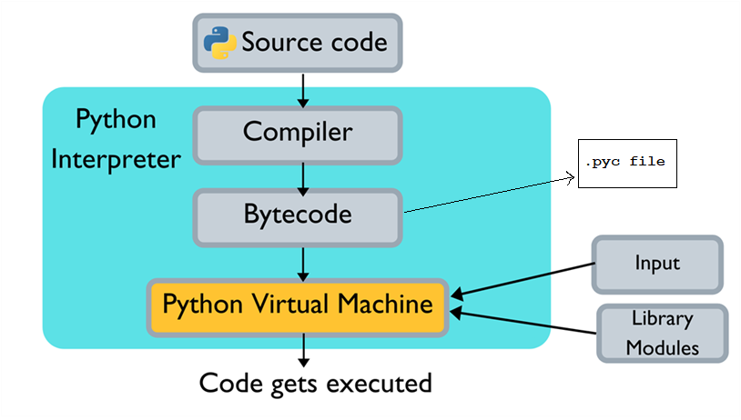
Python Interpreter
Ref: https://www.c-sharpcorner.com

